Slide 1
CSE-422: Data Analytics
Multiple Linear Regression

Slide 2
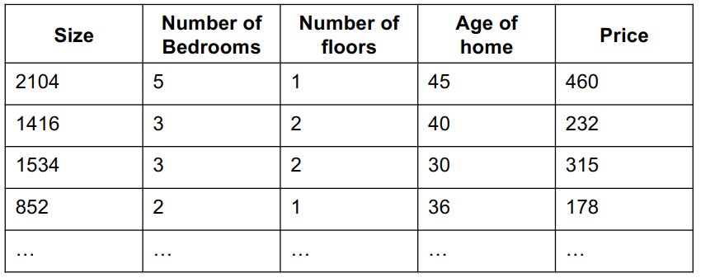
CSE-422: Data Analytics
Multiple Linear Regression
Extension of SLR.
There are many independent variables (also called the explanatory variables) and one dependent variable (response variable)
The price of house depends on many factors

Slide 3
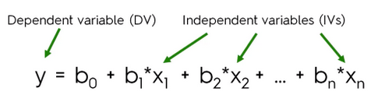
CSE-422: Data Analytics
MLR Equation
The multiple regression equation is interpreted as
For every one unit increase in x₁, y is increased by b₁ amount when all other variables are kept constant.
We are to find the coefficients b₁,b₂,b₃ etc.

Slide 4
CSE-422: Data Analytics
Elements Of A Multiple Regression Equation
Y=a + b₁X₁ + b₂X₂ + b₃X₃
Y is the value of the Dependent variable (Y), what is being predicted or explained.
a = constant or intercept.
b₁ = Slope (Beta coefficient) for X₁.
X₁ = First independent variable that is explaining the variance in Y.
b₂ = Slope (Beta coefficient) for X₂.
X₂ = Second independent variable that is explaining the variance in Y.
b₃ = Slope (Beta coefficient) for X₃.
X₃= Third independent variable that is explaining the variance in Y.

Slide 5
CSE-422: Data Analytics
Example
The Department of Highway Safety wants to understand the influence of various factors on the number of annual highway fatalities.
Null hypothesis: Number of annual fatalities is not affected by total population, days of snow, or average MPH on highways.
Alternative Hypothesis: Number of annual fatalities is affected by total population, days of snow, and average MPH on highways.
Dependent variable: Y is the number of traffic fatalities in a state in a given year
Independent variable: X₁ is the state's total population; X₂ is the number of days it snowed; X₃ is the average speed drivers were driving at for that year.

Slide 6
CSE-422: Data Analytics
Example
Equation: Y = 1.4 + .00029 X₁ + 2.4 X₂ + 10.3 X₃
Predicted value of Y: If X₁=3,000,000, X₂=2, and X₃=65,
Then Y = 1.4 + .00029 (3,000,0000) + 2.4 (2) + 10.3 (65) = 1545.7
a=1.4, This is the number of traffic fatalities that would be expected if all three independent variables were equal to zero (no population, no days snowed, and zero average speed).

Slide 7
CSE-422: Data Analytics
Example
b₁=.00029, If X₂ and X₃ remain the same, this indicates that for each extra person in the population, the number of yearly traffic fatalities increases by .00029.
b₂=2.4, If X₁ and X₃ remain the same, this indicates that for each extra day of snow, Y increases by 2.4 additional traffic fatalities.
b₃= 10.3, If X₁ and X₂ remain the same, this indicates that for each mph increase in average speed, Y increases by 10.3 traffic fatalities.

Slide 8
CSE-422: Data Analytics
Significance of Correlation Coefficients
b₁,b₂,b₃ are the estimates of actual values since we are working with sample data.
Being an estimate, you cannot be sure that your estimate of b₁ is the true value of the effect of X₁ on Y.
We Need something more to know how accurate our estimate is.
This measure is called p-value.
If p<0.05, we say our coefficients are significant (or that we have actually found an effect)
Notes:
The level of statistical significance is often expressed as a p-value between 0 and 1. ... A p-value less than 0.05 (typically ≤ 0.05) is statistically significant. It indicates strong evidence against the null hypothesis, as there is less than a 5% probability the null is correct (and the results are random).

Slide 9
CSE-422: Data Analytics
Standardized Regression
Sometimes, when variables are on different scales, we can standardize them before regression analysis.
This can be done using the z-scores.
Especially helpful in trying to find out the “weight” of each variable when doing multiple linear regression.

Slide 10
CSE-422: Data Analytics
MLR Considerations
More independent variables do not mean better model performance.
Sometimes, it can worsen things (Overfitting!)
The many independent variables do not only have relationship with the dependent variables. They can also be related to each other.
This is called multicollinearity.
We don’t not want multicollinearity.
Also, we want all the independent variables to contribute to the dependent variable. If any does not, get rid of it!

Slide 11
CSE-422: Data Analytics
Why is Multicollinearity bad?
Regression coefficients are used to assess the relative influence of independent variables.
This kind of analysis makes sense when multicollinearity is small.
When one independent variable is highly correlated with another independent variable the contribution of that independent variable is influenced by other independent variables.
As a result, estimates for regression coefficients can be unreliable.

Slide 12
CSE-422: Data Analytics
Steps to Perform MLR
Decide on potential dependent variable and independent variables.
Collect data on variables.
Find relationship of each independent variable with the dependent variable (through correlation/scatter plot)
Find relationship between all independent variables (check for multicollinearity).
Use the best fitting model to make predictions about the dependent variable.

Slide 13

CSE-422: Data Analytics
VIF for Multicollinearity Detection
When there are many independent variables, finding relationship for all of them with others is difficult.
Variance inflation factor can be used instead.

Slide 14
CSE-422: Data Analytics
VIF Calculation
The dependent variable is removed from the picture.
Each independent variable is regressed against all other independent variables.
The resultant R² value is used to represent VIF mathematically as shown in the following equation

Slide 15
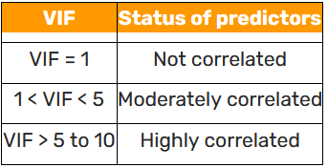
CSE-422: Data Analytics
VIF Interpretation
Drop the variable with high VIF!

Slide 16
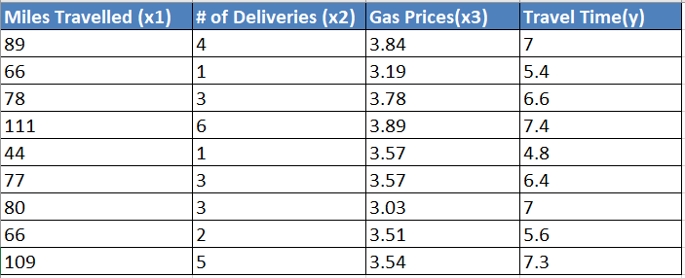
CSE-422: Data Analytics
Task
Perform step 3,4 given on slide 36 for this data.
Notes:
Brandon foltz.

Slide 17
CSE-422: Data Analytics
Adjusted R²
Explore what an adjusted R² is.
One simple explanation here
Adjusted R-Square

